Slide 1


Titolo presentazione sottotitolo
MyTaxiService
Milano, XX mese 20XX
Design Document presentation

Slide 2
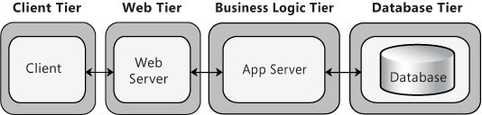
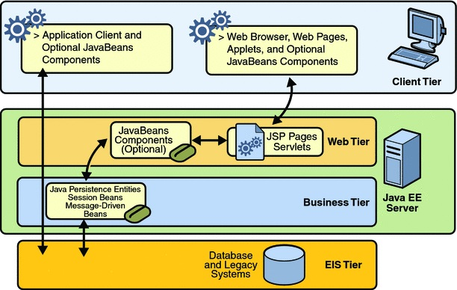
Four Tier Architecture and JEE
We thought our system with a four tier architecture, in order to be
compatible with a JEE Architecture implementation.
However, we do not want to limit the ways it could be implemented, so we
will present the JEE as an example, not as a constraint.

Slide 3
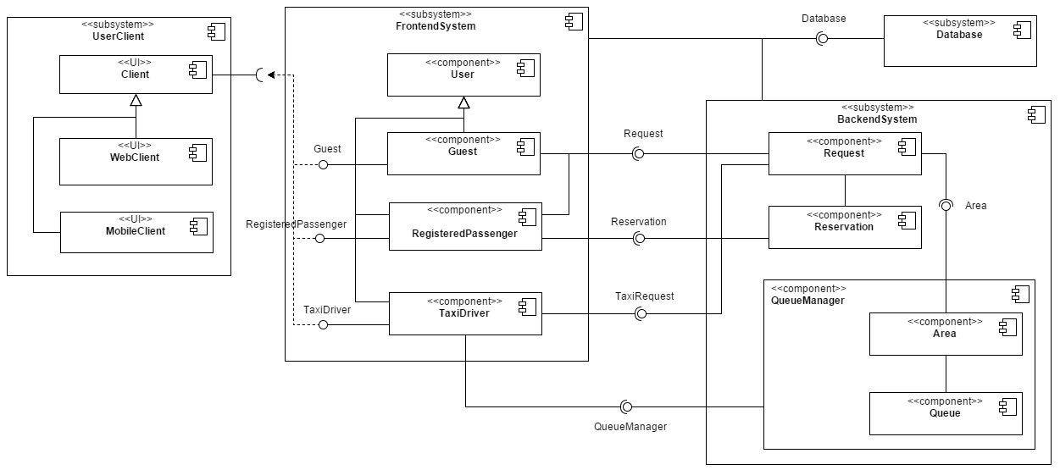
Component Diagram

Slide 4
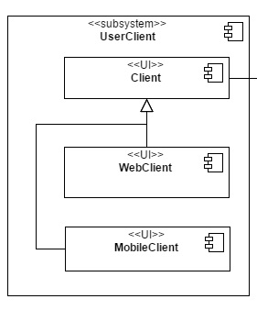
Client
In this subsystem we have the components in direct contact with the user.
It can be considered the user's "access interface" of our system.

Slide 5
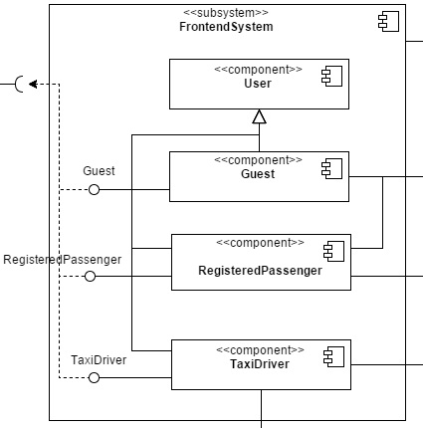
Frontend
This subsystem represents the access to the real functionalities of our system.
The application requires a different type of user (that depends on the login) and, through the components of the Frontend, calls the services of the backend.

Slide 6
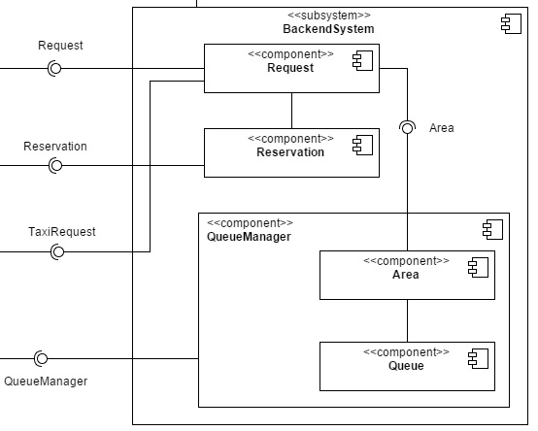
Backend
In this subsystem we have placed all the components that we do not want to let the client interact directly.
It is in direct communication with the frontend, responsible of the user management, and the database. This is practically the core of our system.

Slide 7
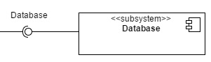
Database
This component is, obviously, the database of our system. It stores all the persistent data that are often required by the Backend and the Frontend systems.
Database component is singleton, it is created once and it is used during the whole life cycle of the system.

Slide 8
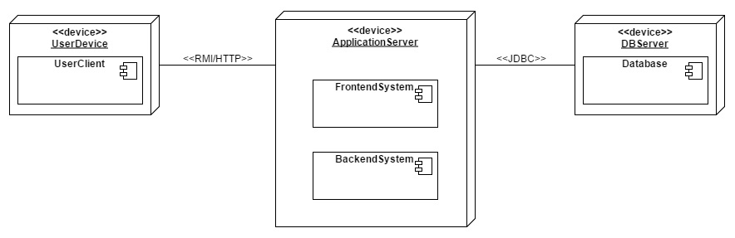
Deployment view

Slide 9
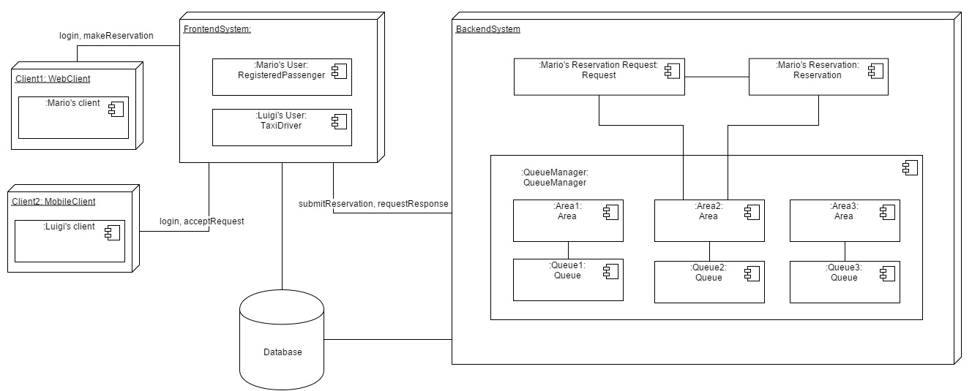
Runtime view

Slide 10
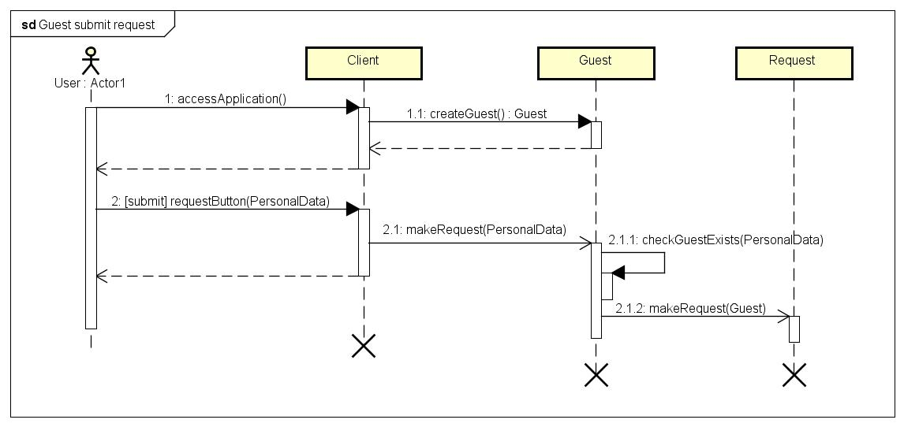
Sequence Diagram – Guest submit request

Slide 11
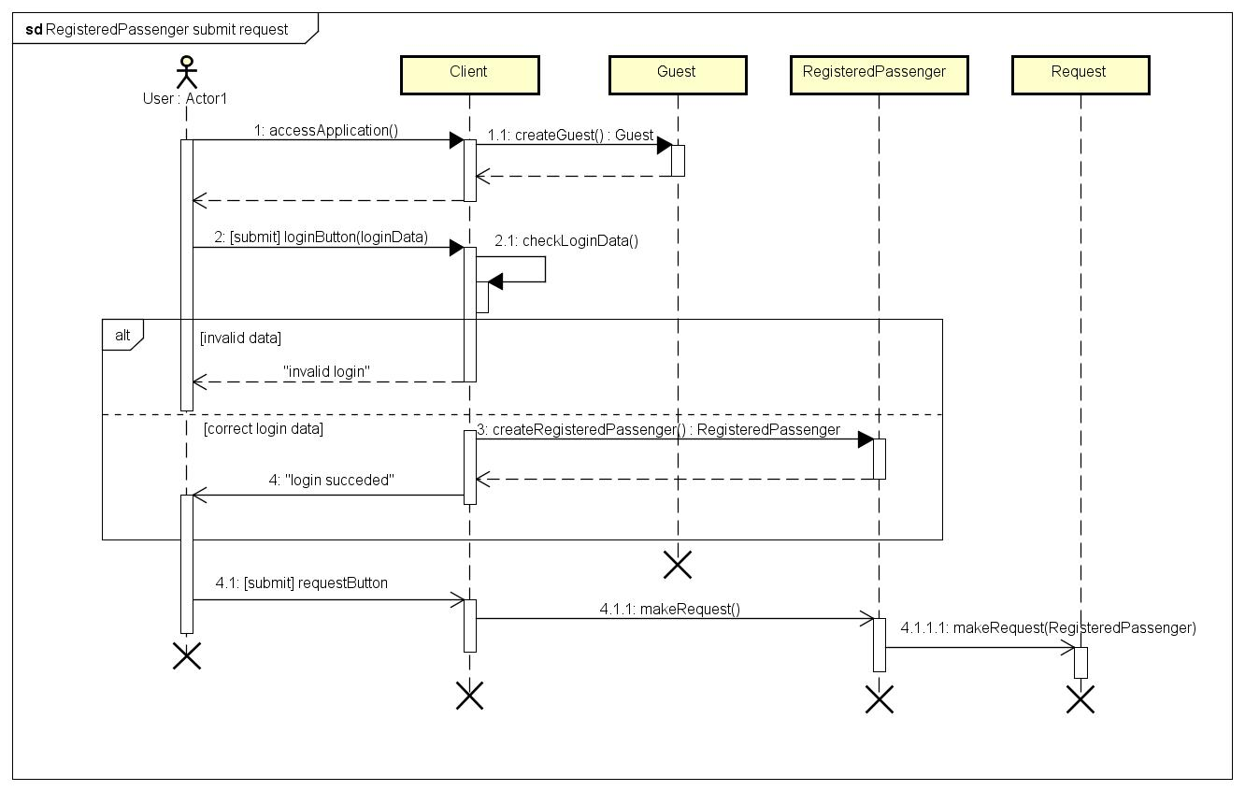
Sequence Diagram – RegisteredPassenger submit request

Slide 12
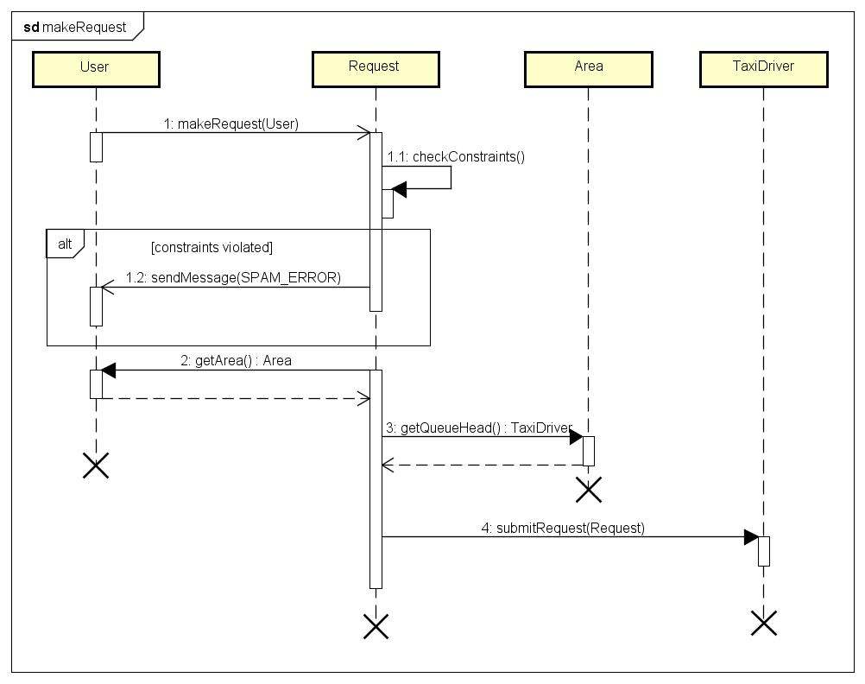
Sequence Diagram – Make Request

Slide 13
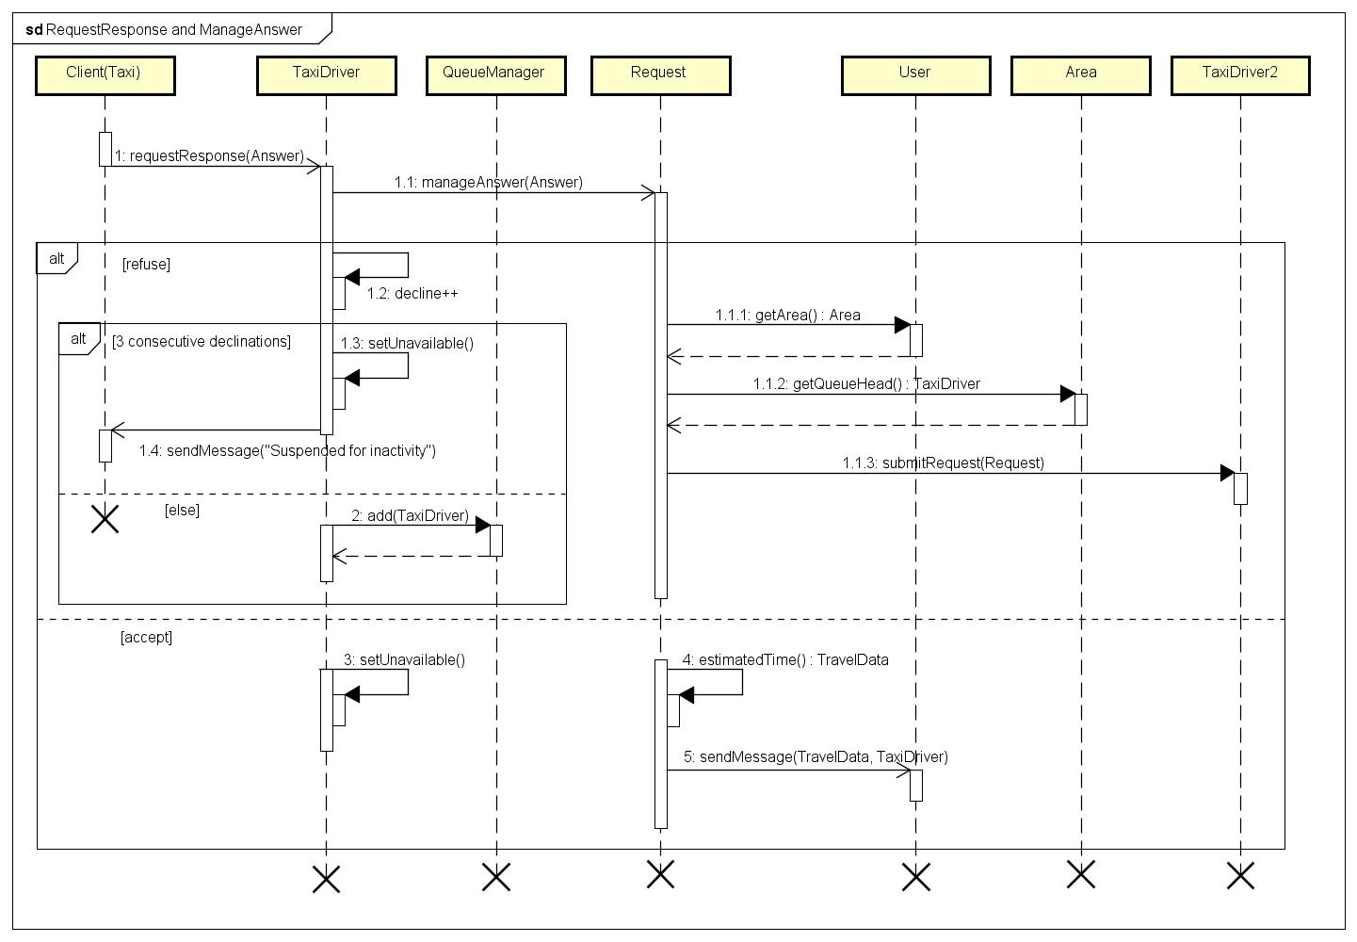
Sequence Diagram – Request response and Answer management

Slide 14
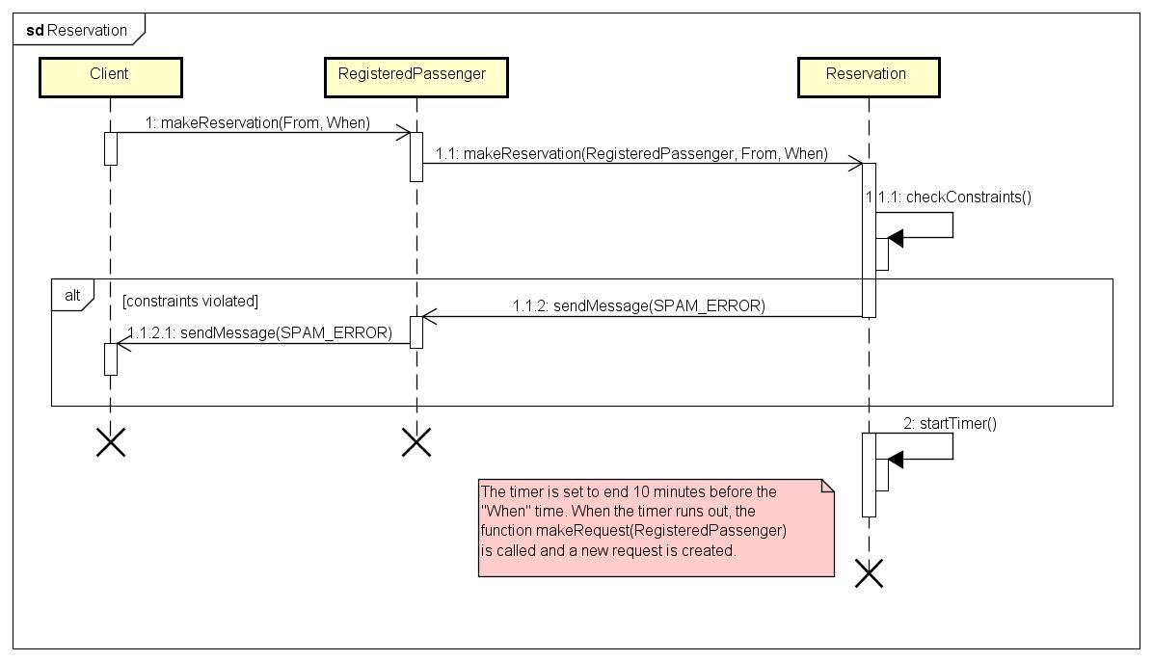
Sequence Diagram – Reservation

Slide 15
Architectural styles and patterns - suggestions
The first, and probably the most relevant, is the four tier architecture. Our system is designed to support a JEE architecture with a thin client on the user device, which is used only as a interface, and a, relatively, fat server that processes all the operations.
An MVC approach has been followed. The user interfaces in the User-Client (view) are used only for data exploration and command submission by the user. The backend operates and processes (controller) the requests coming from the user interfaces and interacts with the persistent and dynamic (but global, like areas and queues) data belonging to the model.
JMS is a good way to solve the "messaging problem". JMS is a services provided by JEE in its architecture. Its goal is to manage the point-to-point message delivery in an asynchronous way, simply specifying who has to receive a notification. A similar approach can be reproduced also without the JMS constraint.
There are two patterns that could be useful during implementation:
Factory Method useful for components that must be continuously created, maybe also by different components or as a result of different commands, like Users (Guest, ecc.), Requests and Reservations. This allows a stronger control on the instance creation.
Singleton useful for components which needs only one instance in the whole system.

Slide 16
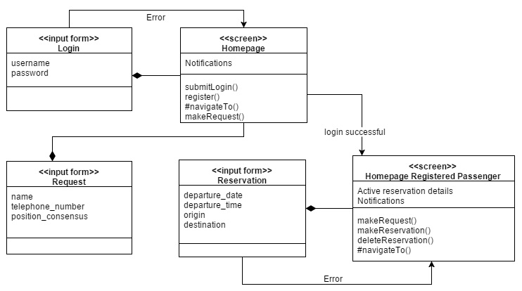
User Experience – Traditional user

Slide 17
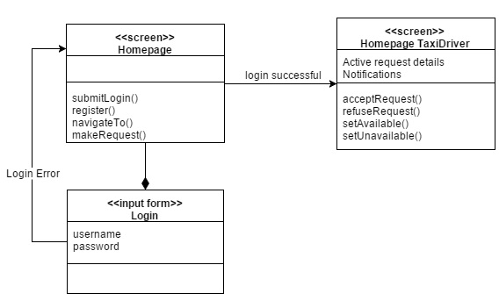
User Experience – Taxi Driver

